Slide 1
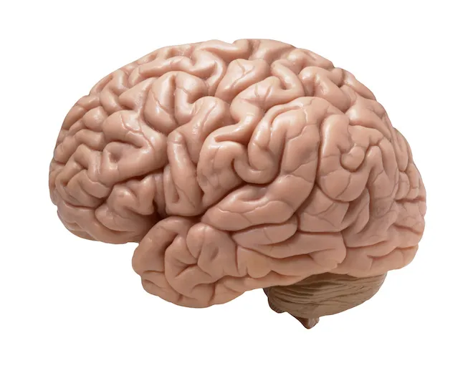
Our Amazing Brains

Slide 2
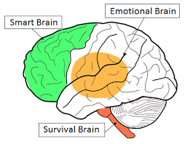
How many different emotions can you name?
Our Emotional Brains

Slide 3
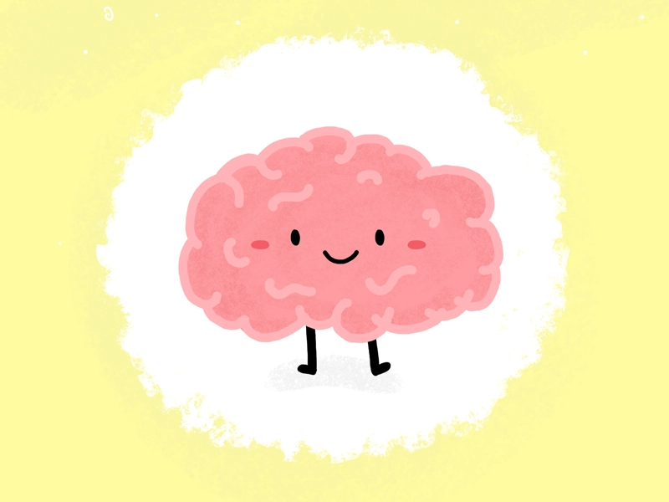
Our happy Brains
How can we make our brains happy?

Slide 4
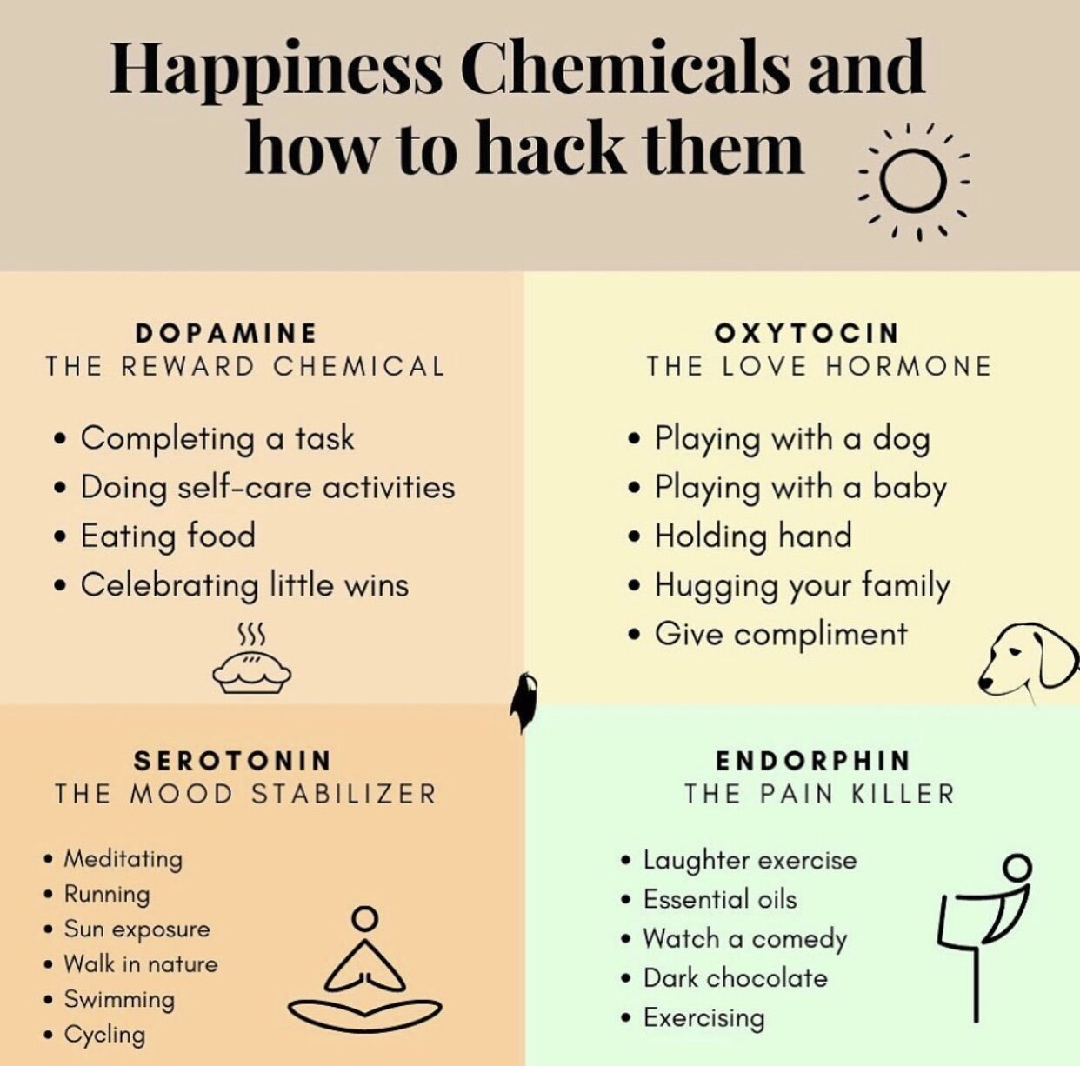

Slide 5
Dopamine...
Complete a Task

Slide 6
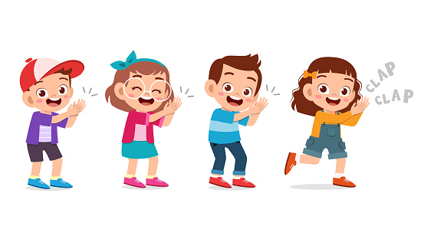
Dopamine...
Celebrate Little Wins

Slide 7
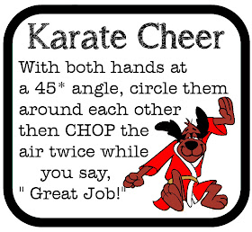
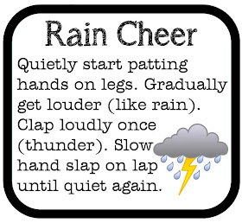
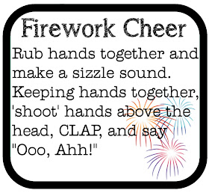
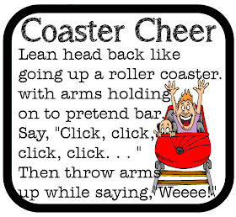

Slide 8
How Will We Boost Our Happiness This Week?
Create little goals
Notice and celebrate little wins
Notice and celebrate other people’s little wins

Slide 10
How Will We Boost Our Happiness This Week?
Give compliments
Give hugs
Look at cute animals

Slide 11
Can we give compliments?
Write your name at the bottom of your paper.
Pass it to the person on your right.
Write a compliment for the person at the bottom of your new sheet of paper then fold the top over.
Keep passing it along until you get your name back
Compliment Ideas
You are kind
Funny
Helpful
Caring
A good listener
You look after others when they are sad.
You have great ideas.
You have a nice smile
You let others join your games

Slide 13
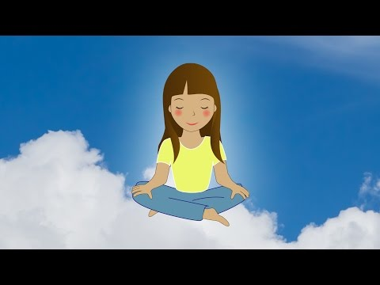
Can we try Meditation?

Slide 14
Who knows a joke?
What has four wheels and flies?
A garbage truck!

Slide 15
Who knows a joke?
Why are fish so smart?
Because they live in schools.

Slide 16
Who knows a joke?
Why did the old man fall in the well?
Because he couldn’t see that well!

Slide 17
How can we improve our mood?
When I feel _______,
I can _________ .

