Slide 1
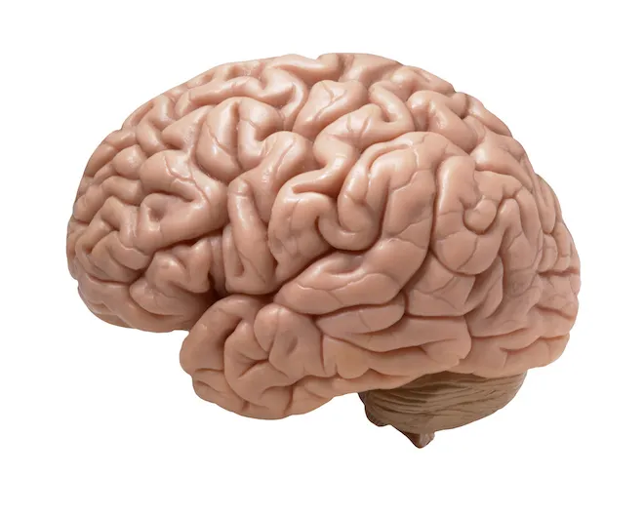
Our Amazing Brains
Do you already know anything about the brain?

Slide 2
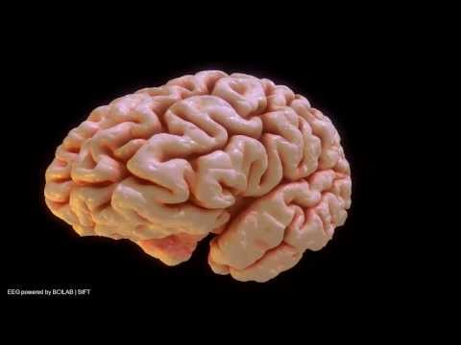
Our Amazing Brains

Slide 3
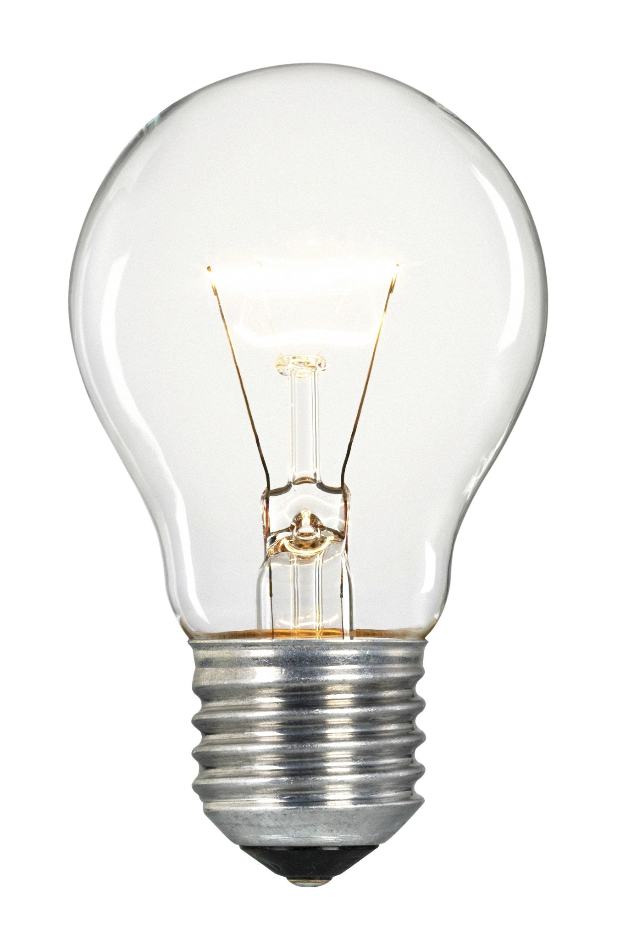
True or False
Your brain makes enough electricity to power a lightbulb.
Notes:
True

Slide 4
True or False
Your brain goes to sleep
when you do.
Notes:
False

Slide 5
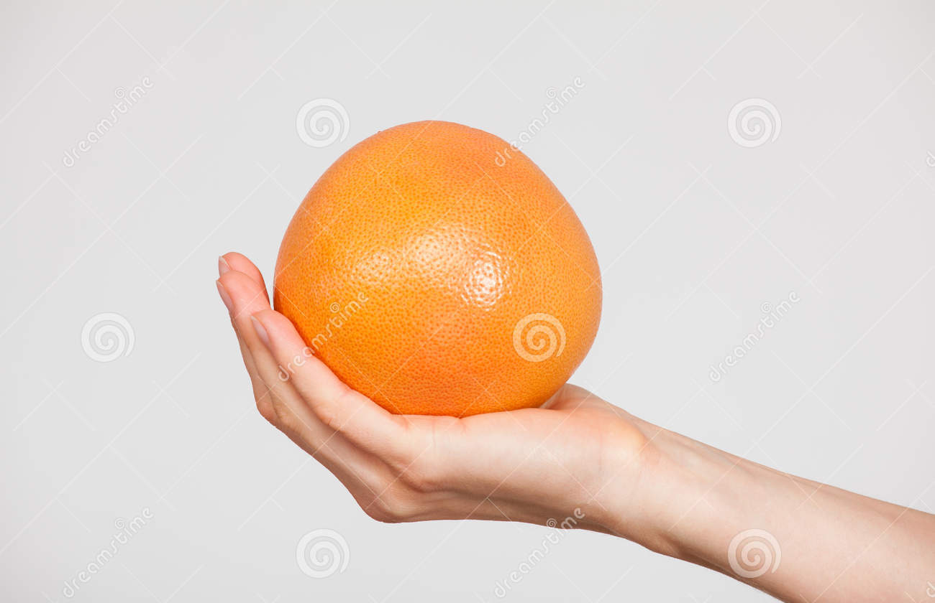
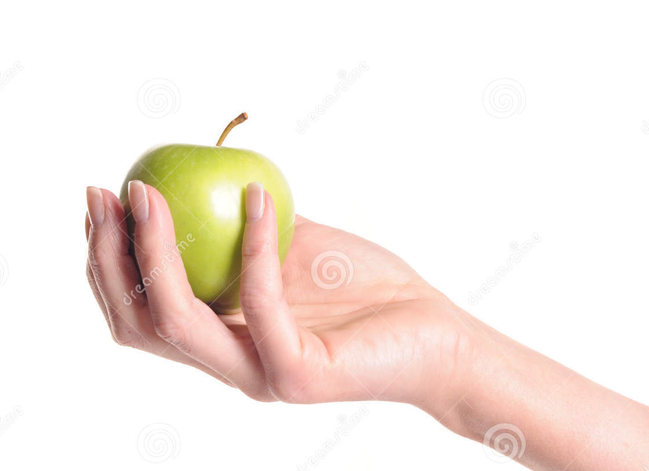
True or False
An adult brain is about
the size of an apple.
An adult brain is about
the size of a grapefruit.
Notes:
True- grapefruit

Slide 6
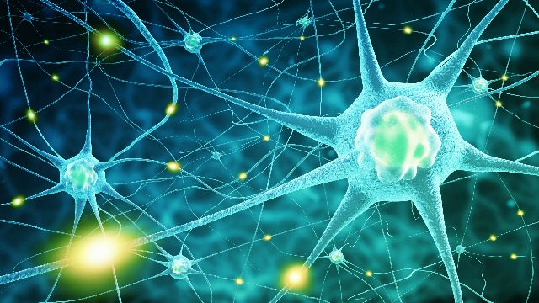
True or False
Your brain has almost
100 billion neurons.
Your brain has almost
1000 neurons.
Notes:
True- 100 billion neurons

Slide 7
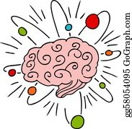
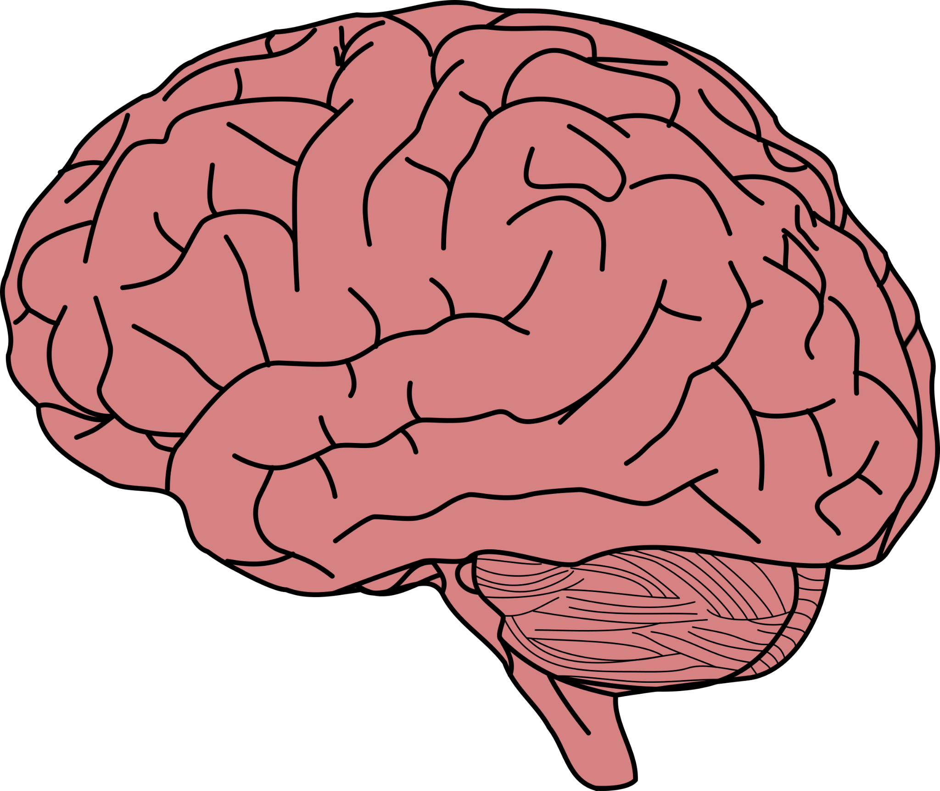
True or False
Your brain stays the same for your whole life.
Everytime you learn something new,
your brain changes a bit
Notes:
True- brain changes

Slide 8
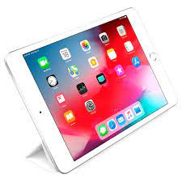
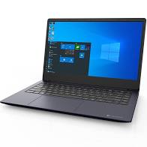
True or False
An adult brain weighs about the
same as a laptop computer.
An adult brain weighs about
the same as an iPad.
Notes:
True- laptop

Slide 9
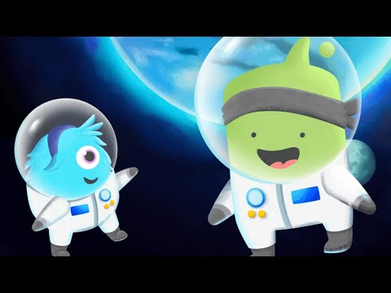
Are you ready to hear a secret about the brain?

